Slide 1
SYRACUSE
Syracuse Football Targeted Advertisement
Sam Bull
Dorothy Fang
IST 659 Fall 2020

Slide 2
TABLE OF CONTENTS
01
03
05
SUMMARY
GOALS
DATA QUESTIONS
02
04
06
CURRENT SCENARIO
ERD
FORMS AND REPORTS
background information
what we want to accomplish
what our users might ask
advertisement tactics
entity relationship diagram
implementation

Slide 3
SUMMARY
Since Governor Cuomo signed Executive Order No. 203.3 on March 12, 2020, suspending all gatherings of more than 50 people, Syracuse University Football has shifted its entire marketing strategy with an objective to upkeep its football game viewership

Slide 4
CURRENT SCENARIO
Geographic based advertisement
Lacking of personalized advertisement

Slide 5
OUR GOALS
RELATIONAL DATABASE MANAGEMENT SYSTEM
PERSONALIZED ADS
CENTRALIZED
DATABASE
01
02
03

Slide 6
07
BUSINESS RULE
HOME
12:34
VISITOR
Only three devices can be used while simultaneous streaming.
A company must have at least $5,000 invested in their advertising budget.
Devices must be one of four options: Television, Smart Phone, Tablet, Laptop, Desktop, or Other
Subscription plan type must be one of the following: 7-Day Free Trial, Basic, Premium, or Other
Network Provider must be one of the following: Verizon Fios, Spectrum, AT&T, Hulu TV, YouTube TV, Playstation Vue, or Cuse TV.
Target Age Demo must fit into one of the following: Under 18, 18-24, 25-39, 40-55, 56-74, 75+
Advertisement Type must be one of the following: Ad Read by Commentators, Commercial, Graphic w/ QR Code
Advertisement Duration must be one of the following: 15 sec, 30 sec, 45 sec, 60 sec
The placement of an ad in the game must fall under one of these categories: Pre-Game, First Quarter, Second Quarter, Halftime, Third Quarter, Fourth Quarter, Post-Game
Only regular season games will be observed.
Over 20% of people who saw the ad need to interact with it for it to be considered a success.
Contracts are 10-year long.

Slide 7
DATA QUESTIONS
Which advertisement had the most impressions?
Does the placement of the ad in game influence the engagement rate of the advertisement?
What device was in use the most among customers?
What advertisements were successful?
For games played in 2020, which games had the highest number of engaged audience?
What type of subscription plan was most used for the network providers?
Which ad agreement and ad contract is about to expire?
SYRACUSE FOOTBALL

Slide 8
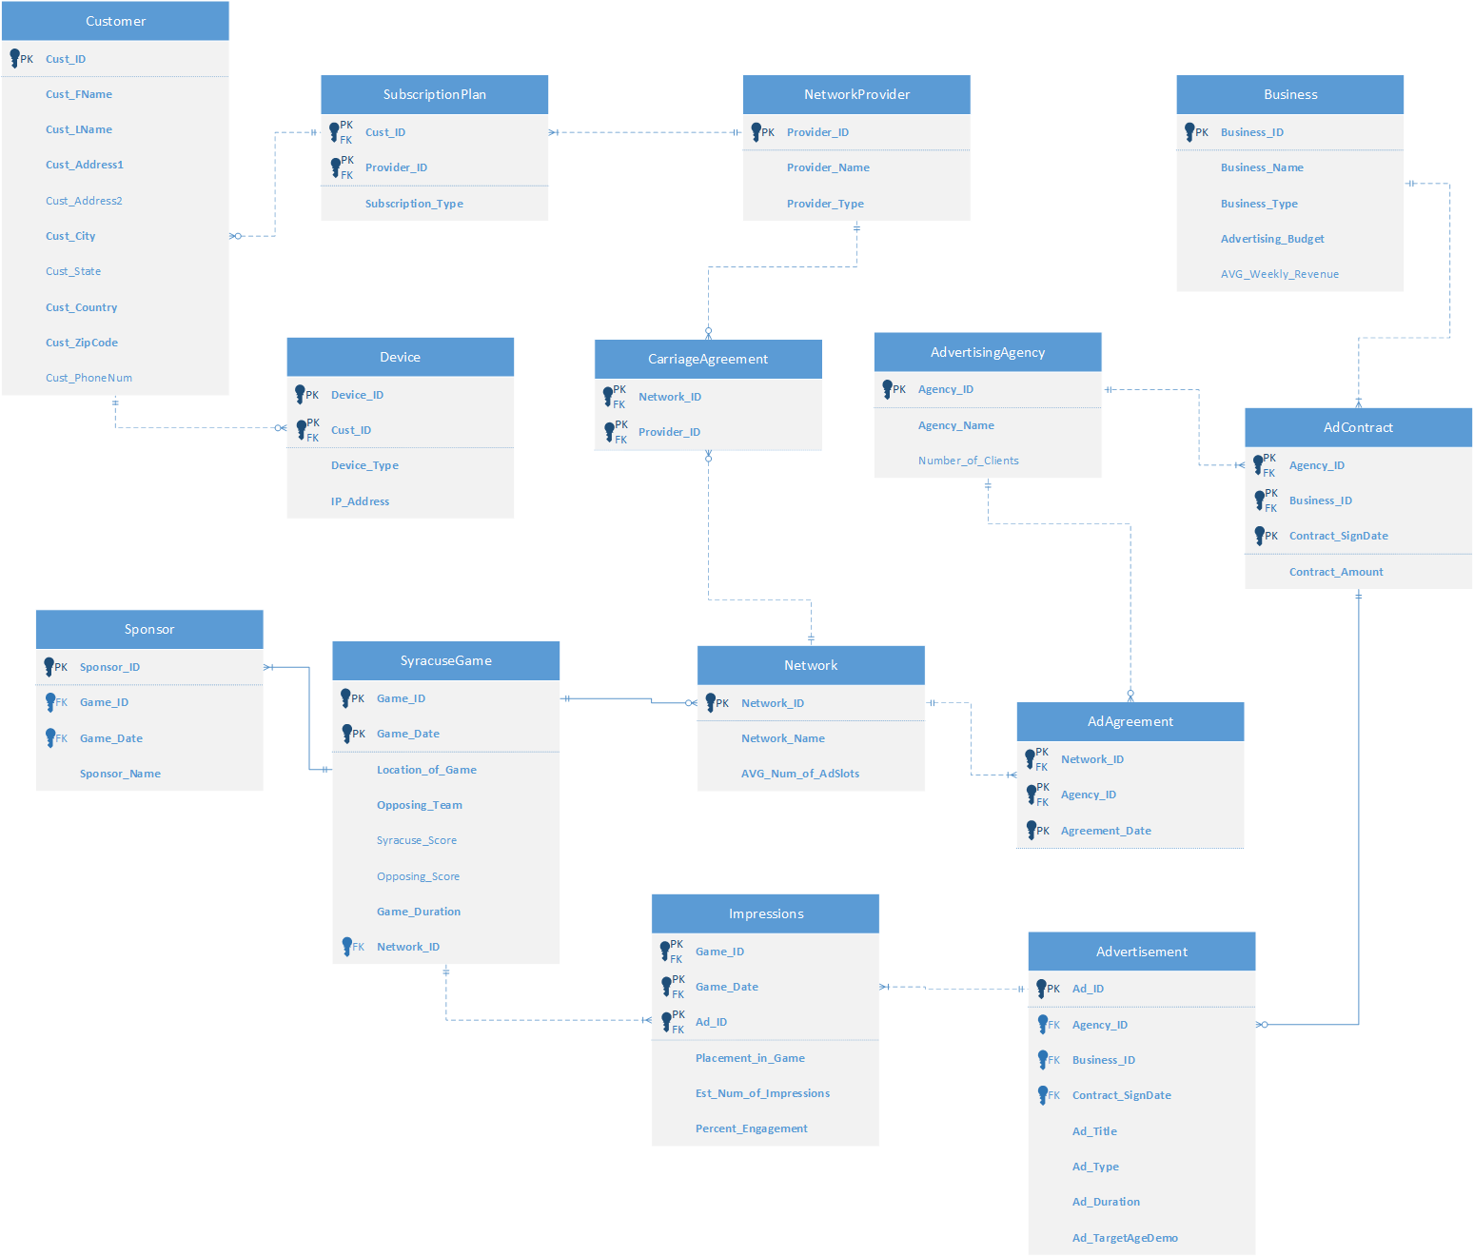
ENTITY RELATIONSHIP DIAGRAM

Slide 9
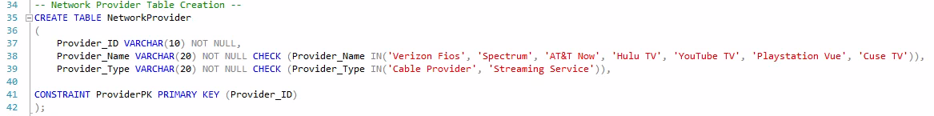
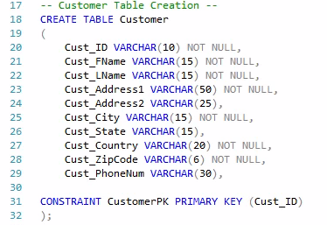
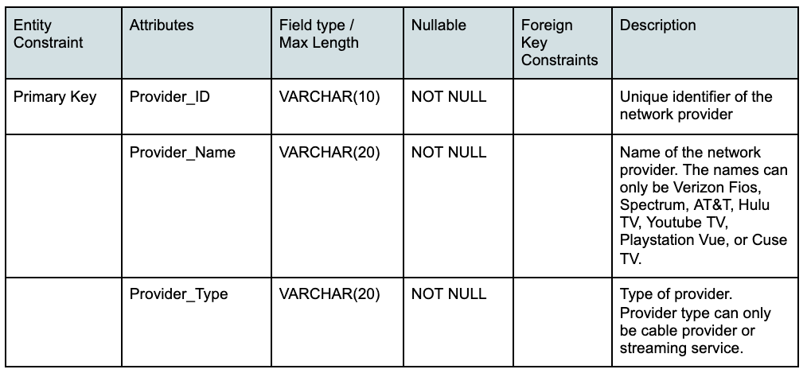
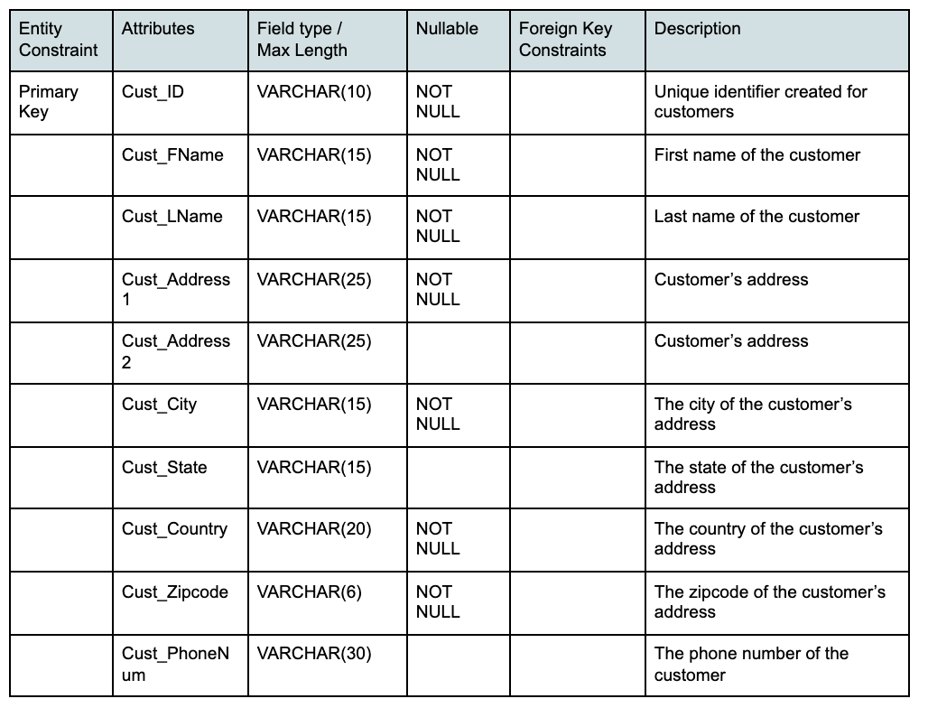
TABLES
Network Provider
Customer

Slide 10
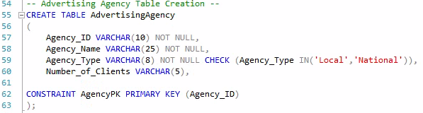
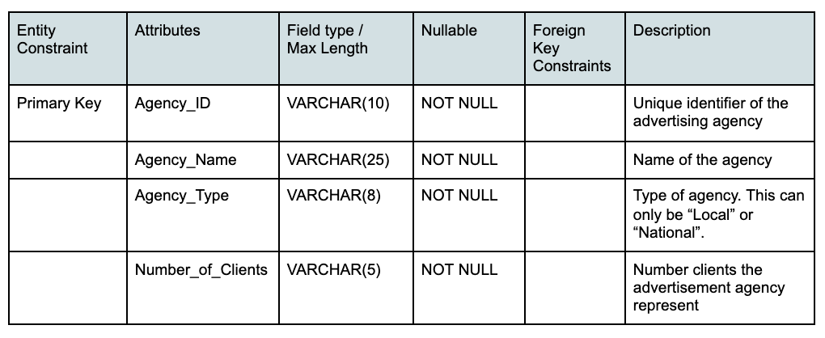
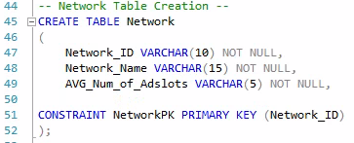
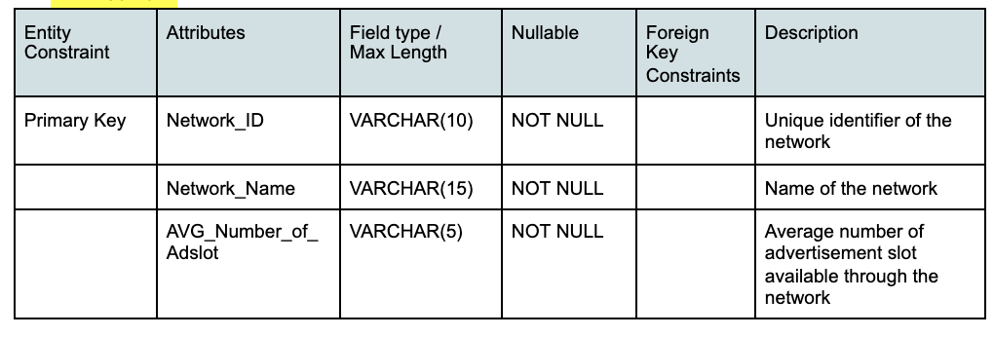
TABLES
Advertising Agency
Network

Slide 11
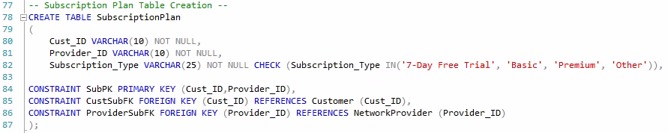
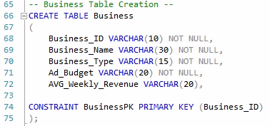
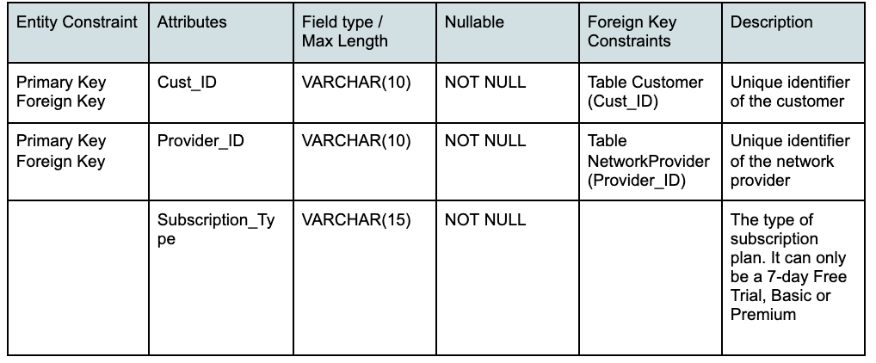
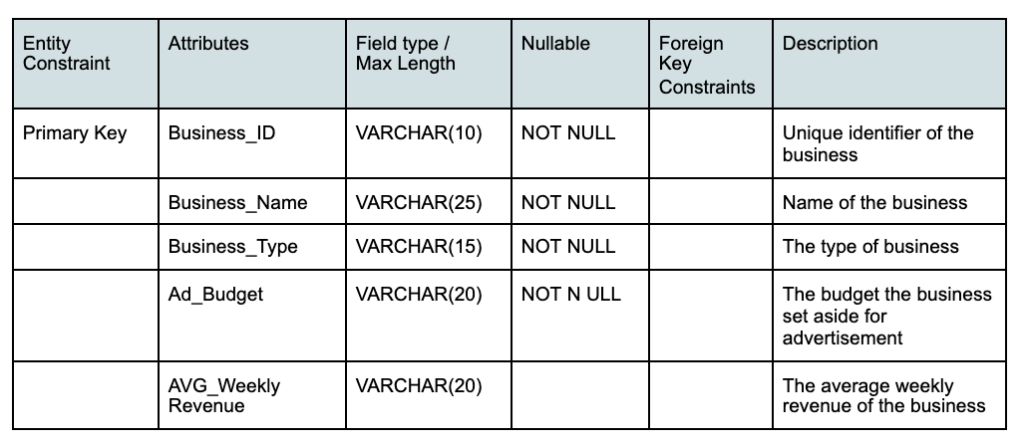
TABLES
Subscription Plan
Businesses

Slide 12
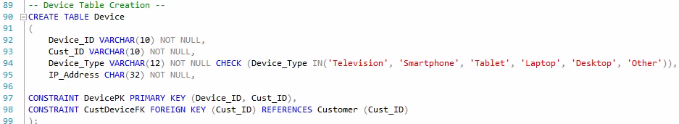
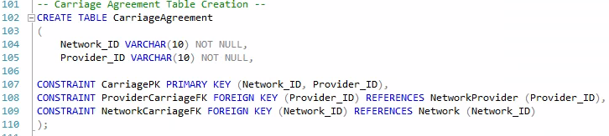
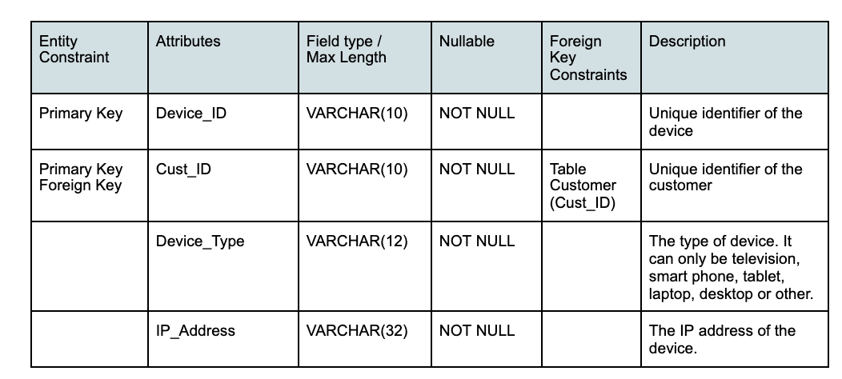
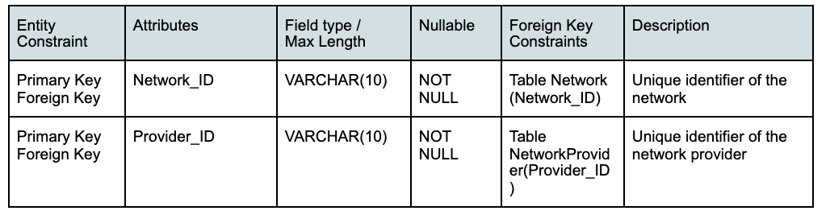
TABLES
Device
Carriage Agreement

Slide 13
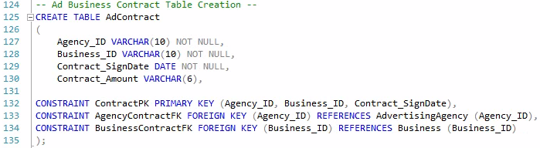
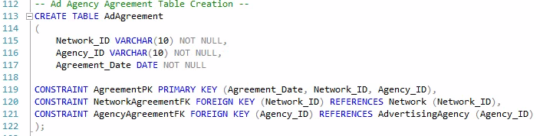
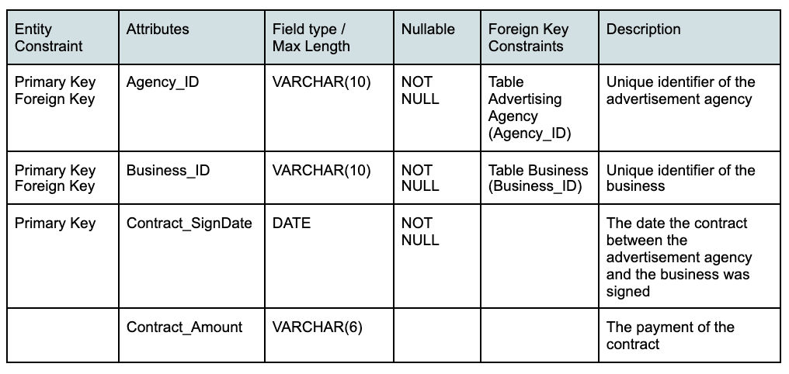
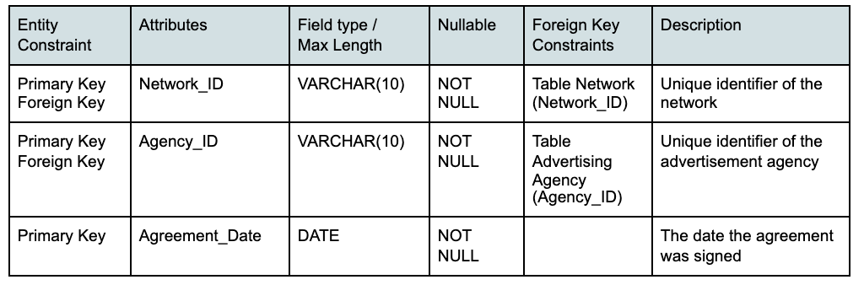
TABLE
Agency/Business Contract
Ad Agency Agreement

Slide 14
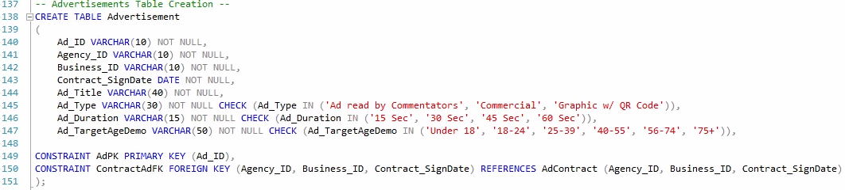
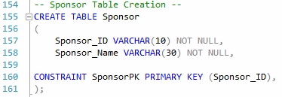
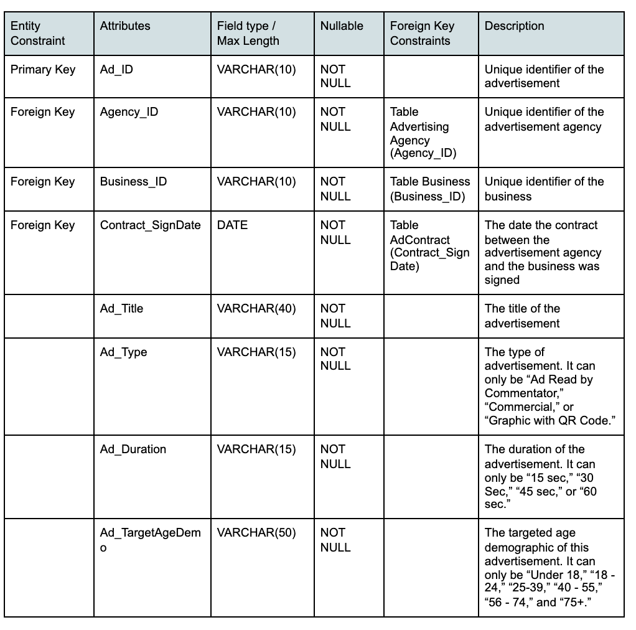
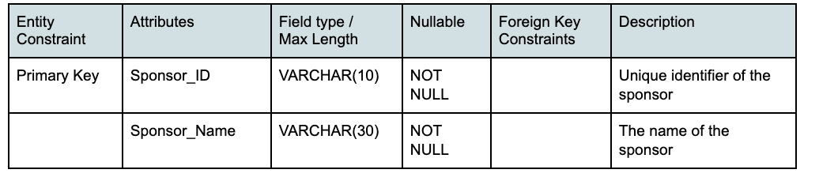
Tables
Advertisements
Sponsors

Slide 15
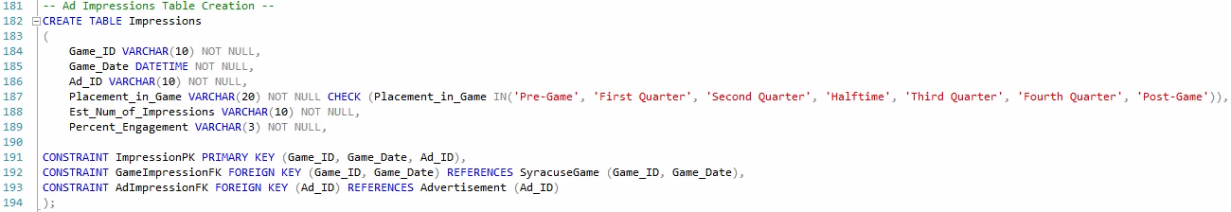
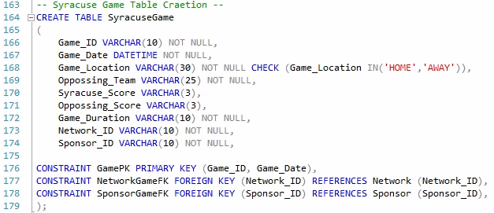
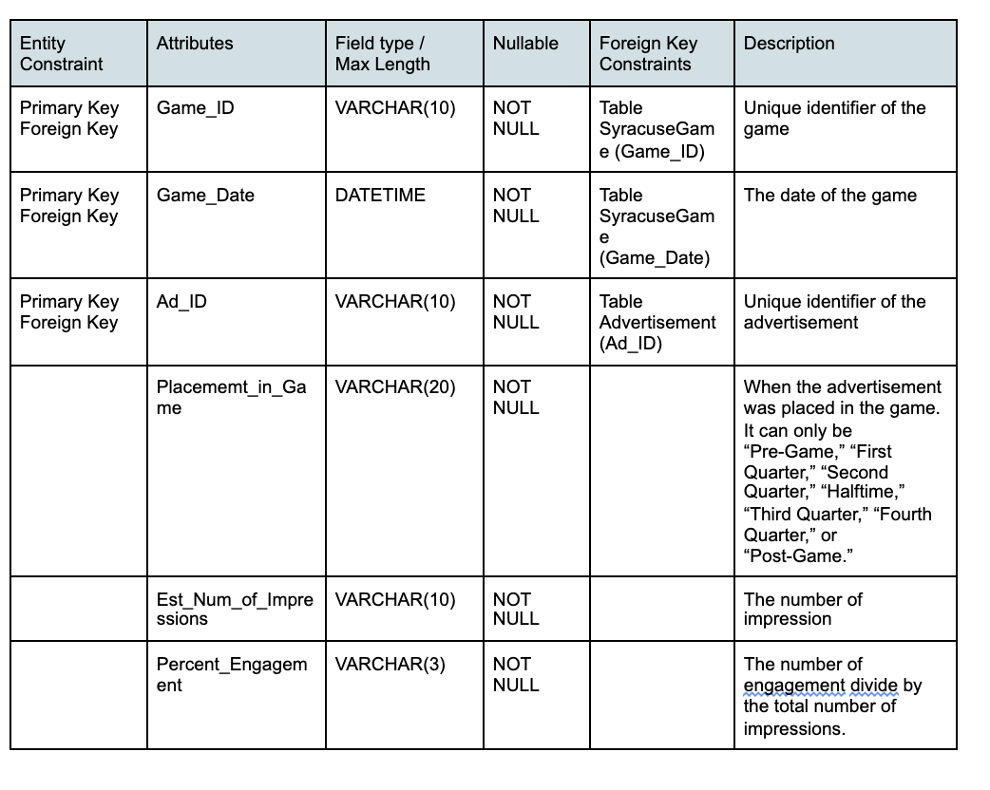
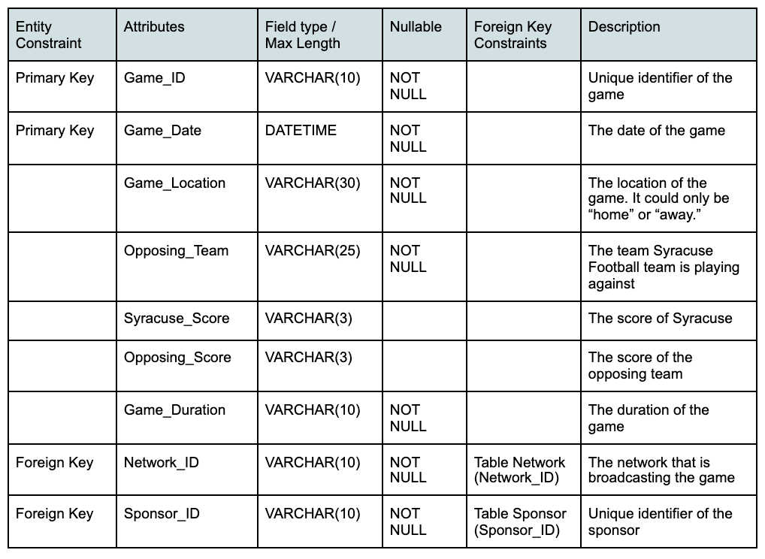
Tables
Ad Impressions
Games

Slide 16
INTERFACE IMPLEMENTATION

Slide 17
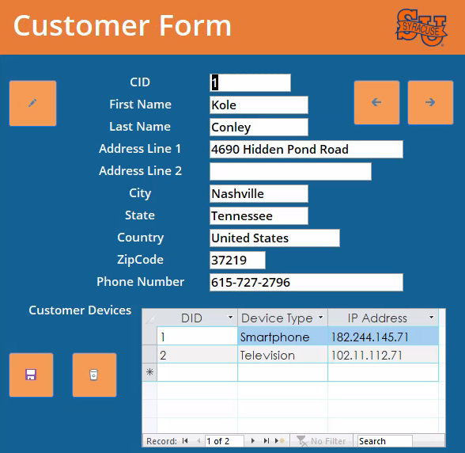
Some Forms
Customers (w/ Devices)

Slide 18
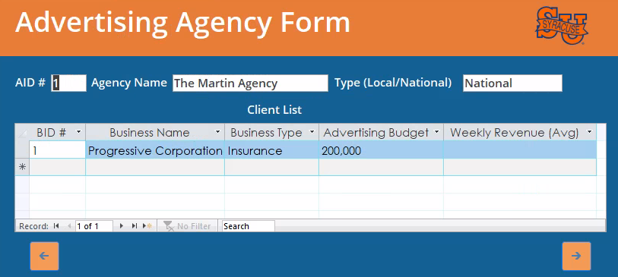
Some Forms
Advertising Agency (w/ their Clients)

Slide 19
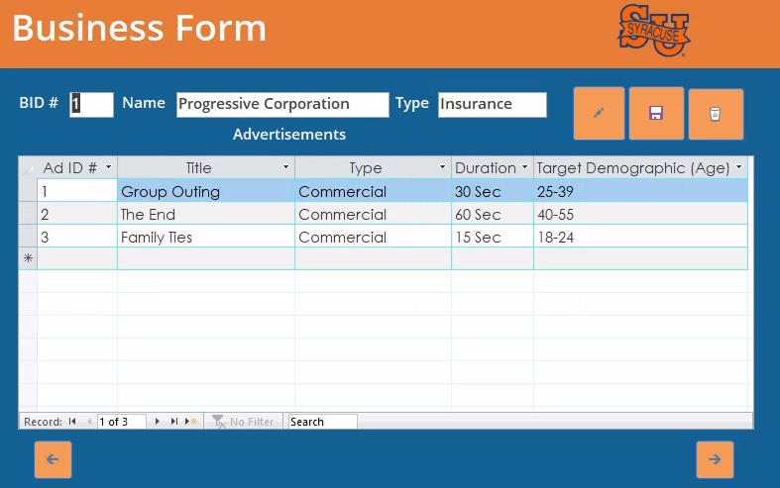
Some Forms
Businesses
(w/ Individual Ads)

Slide 20
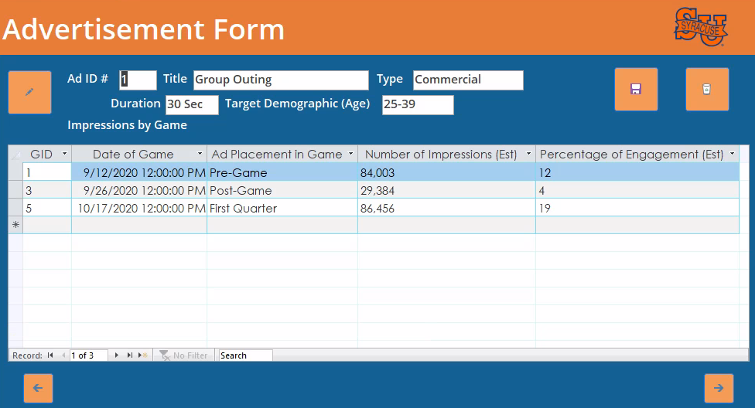
Some Forms
Advertisements (w/ Impressions by Game)

Slide 21
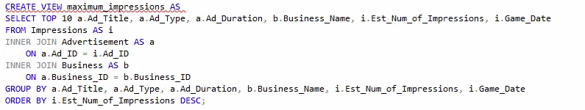
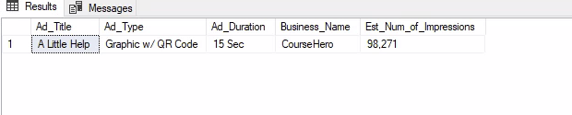
DATA QUESTION: Which advertisement had the most impressions?

Slide 22
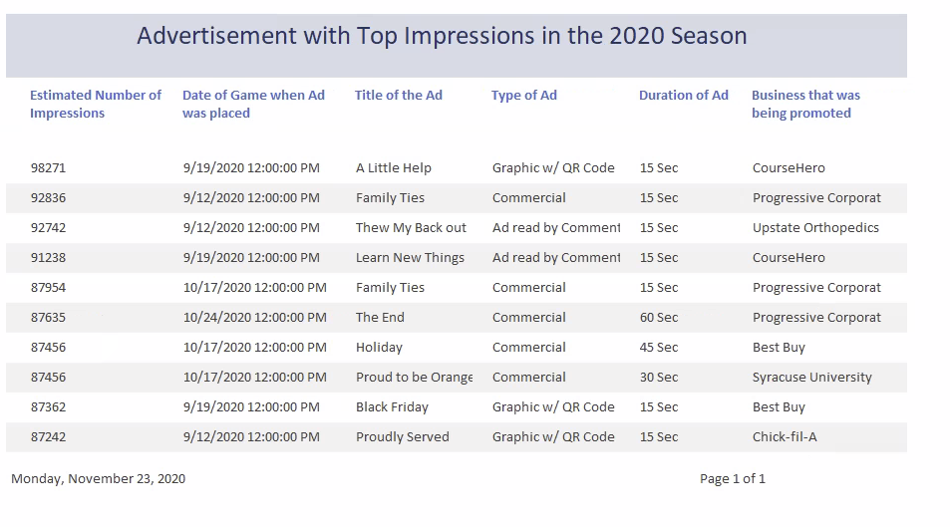
REPORT

Slide 23
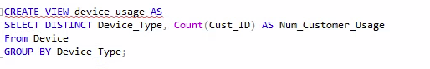
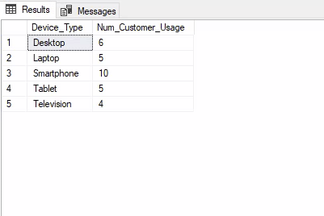
DATA QUESTION: What device was in use the most among customers?

Slide 24
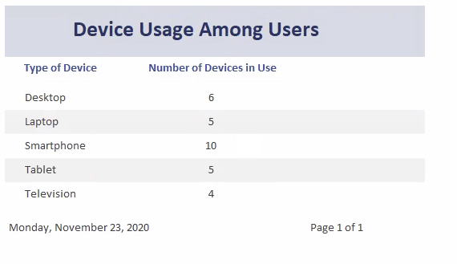
REPORT

Slide 25
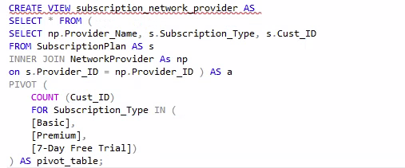
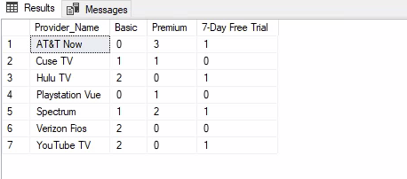
DATA QUESTION: What type of subscription plan was most used for the network providers?

Slide 26
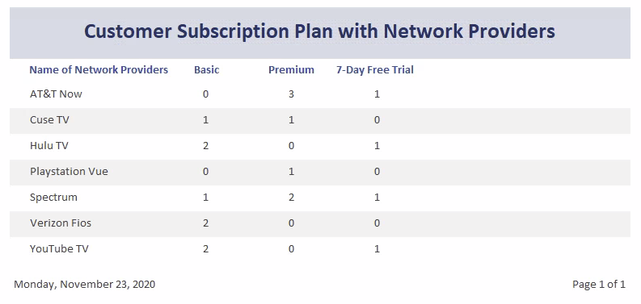
REPORT

Slide 27
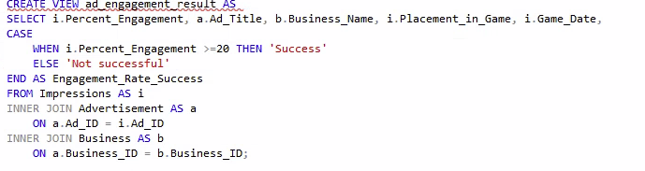
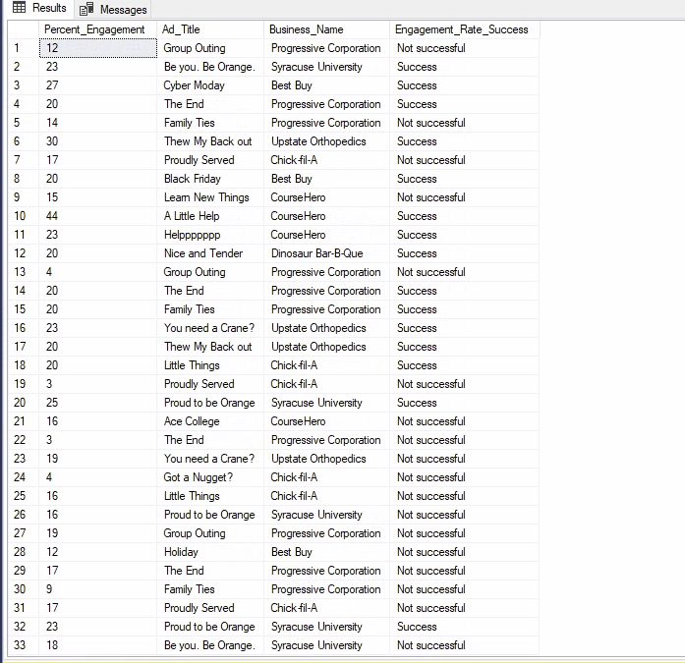
DATA QUESTION: Which advertisements were successful?

Slide 28
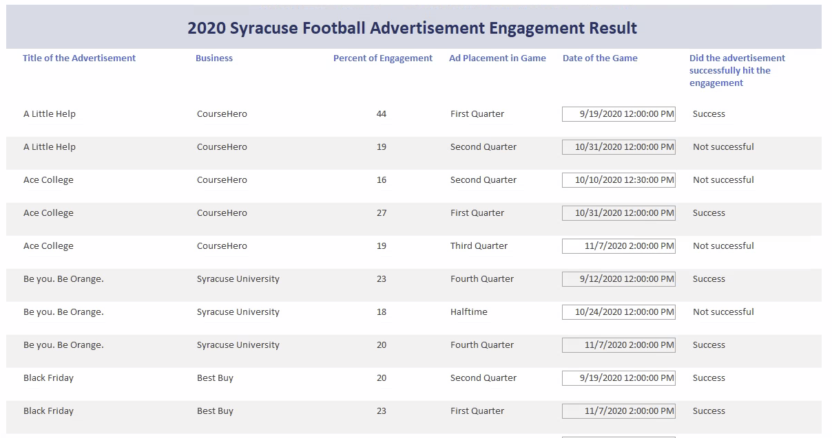
REPORT

Slide 29
WHAT TO IMPROVE?
DATA
SECURITY
MORE METRICS
SCALING
UP
01
02
03

Slide 30
THANKS!
Do you have any questions?

